Slide 1
PIP2001 CAPSTONE PROJECT
A ONE STOP SOLUTION FOR TOURISM
Batch Number:CSE-181
Under the Supervision of,
Mukthala Kiran Kumar -20211CSE0057
Dharisa Sai Jaswanth - 20211CSE0029
Dudekula Riyaz -20211CSE0017
Sriram Sapthagiri -20211CSE0060
Ms.RAMA BAI V
Assistant Professor
School of Computer Science Engineering
Presidency University
Roll Number | Student Name

Slide 2
Introduction
The inspiration for this project comes from the increasing need for efficient services in the hospitality and event industries.By addressing the complexities of booking and management, we aim to enhance user convenience, optimize service provider operations, and foster a seamless experience, ultimately contributing to the digital transformation of service industries. In today’s fast-paced digital world, the tourism industry is undergoing a significant transformation as it adapts to the increasing demands of travelers who prioritize convenience, efficiency, and seamless experiences. With globalization bringing people closer together, the ability to access, book, and manage tourism-related services has become essential for modern travel. Travelers now expect integrated platforms that address all aspects of their journeys, from choosing accommodations and participating in events to arranging transportation. This report presents a comprehensive platform aimed at changing how users engage with key elements of the tourism landscape—hotels, events, and transportation—while also equipping service providers with advanced management tools.

Slide 3
Literature Review
Design and Implementation of Hotel Room Management System
• Authors: Wei Wei and Zhengwei Lou (2019)
• Focus: This study highlights the design and implementation of a comprehensive hotel room management system utilizing modern software tools. The proposed system enhances real-time room allocation, integrates customer feedback, and efficiently manages housekeeping operations. The authors illustrate how these technological advancements improve operational efficiency and guest satisfaction.
• Relevance: It lays the groundwork for adding functionalities such as online bookings, dynamic pricing, and market segmentation, which are essential for contemporary hotel operations.

Slide 4
Literature Review
Hotel’s Online Booking Segmentation for Heterogeneous Customers
• Authors: Z. W. Miao, T. Wei, and Y. Q. Lan (2016)
• Focus: This research explores the diversity among customers who book hotel rooms online. By employing clustering methods, it segments customers according to their booking behavior, preferences, and price sensitivity. The study suggests strategies for personalized marketing to meet the unique needs of different customer groups.
• Relevance: The insights gained from segmentation are vital for creating customer-focused booking systems, which can enhance revenue through targeted pricing and tailored services.

Slide 5
Research Gaps Identified
Existing systems for managing hotels, events, and cabs are often fragmented, requiring users to navigate multiple platforms for bookings. These systems typically lack centralization, leading to inefficiencies in service discovery and management. Admins and service providers face challenges in updating offerings, while users experience a lack of streamlined access to services, resulting in a less efficient experience. 4o
Disadvantages:
• Fragmented platforms create inefficiencies in booking and service discovery.
• Admins struggle with updating offerings across multiple, disconnected systems.
• Users face challenges accessing centralized services for seamless booking experiences.

Slide 6
Proposed Methodology
The proposed system offers a centralized platform for managing hotels, events, and cabs, enabling seamless service discovery and booking. Admins can easily add, update, and manage offerings, while users benefit from a unified interface for exploring and reserving services. The platform enhances operational efficiency, improves user experience, and simplifies interactions between service providers and users, fostering a more streamlined service ecosystem.
Advantages
• Centralized platform for efficient management of hotels, events, cabs.
• Admins can easily add, update, and manage service offerings.
• Users enjoy streamlined exploration and booking of multiple services.
• Enhances operational efficiency and fosters seamless user-provider interactions

Slide 7
Objectives
Input design is centered on transforming a user-friendly description of input into a format that a computer can interpret. This design is essential for reducing errors during the data input process and assisting management in acquiring accurate information from the computerized system. It is accomplished by developing user-friendly data entry screens that can manage large amounts of data. The goal of input design is to streamline data entry and minimize mistakes. The data entry interface is organized to facilitate all necessary data manipulations and includes options for viewing records. After data entry, validity checks are conducted. Users can input data through these screens, and helpful messages are provided as needed to avoid confusion. Thus, the aim of input design is to establish an intuitive input layout.
GOALS: The primary goals in designing UML are to create a visual representation of the system's functionality.
1. To provide users with a ready-to-use, expressive visual modeling language that allows them to create and share meaningful models.
2. To offer mechanisms for extendibility and specialization to enhance core concepts.

Slide 8
Objectives
3. To ensure independence from specific programming languages and development processes.
4. To lay a solid foundation for understanding the modeling language.
5. To encourage the growth of the object-oriented tools market.
6. To support advanced development concepts such as collaborations, frameworks, patterns, and components.
7. To integrate best practices.

Slide 9
System Design & Implementation
The input design acts as a bridge between the information system and its users. It entails creating specifications and procedures for preparing data, ensuring that transaction information is converted into a format suitable for processing. This can be achieved by having the computer read from written or printed documents or by allowing users to input data directly into the system. The primary goal of input design is to manage the amount of input needed, reduce errors, avoid delays, eliminate unnecessary steps, and keep the process straightforward. It is designed to ensure security and user-friendliness while safeguarding privacy. Important factors to consider in input design include:
- What data needs to be input?
- In which way the data should be organized or coded?
- Providing guidance to help personnel enter data.
- Techniques for validating input and the steps to take when errors arise.

Slide 10
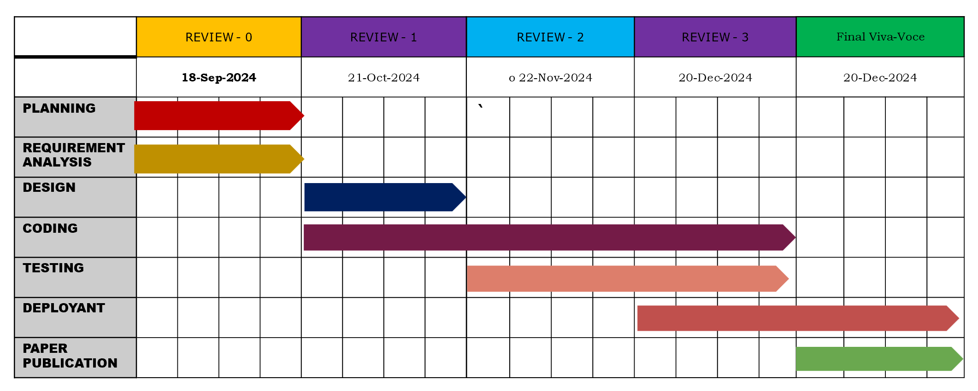
Timeline of Project

Slide 11
Outcomes / Results Obtained
Real-Time Data Access
The application ensures users have access to up-to-date information on hospital services, including bed availability, doctor schedules, and other critical resources. This transparency builds trust in the accuracy of the data and enables users to make informed decisions during emergencies or routine healthcare needs. Real-time updates reduce the frustration of visiting hospitals only to find unavailable services, ensuring a smoother healthcare experience.
User-Friendly Experience
The app is designed with a simple and intuitive interface, making it easy for users of all technical backgrounds to navigate. Key features like searching for hospitals, booking services, or accessing health articles are presented clearly and logically. A user-friendly design improves satisfaction, encourages repeated use, and ensures accessibility for a wider audience, including older adults or those less familiar with technology.
Increased Hospital Utilization

Slide 12
Conclusion
This project successfully creates an intuitive platform for the seamless management and discovery of hotels, events, and cabs. By offering a centralized system, it enhances user experience, facilitating easy exploration and booking of services while also streamlining administrative management. The platform effectively connects users, hotel owners, event organizers, and cab providers, ensuring smooth interactions and efficiency.
The platform enhances operations for all parties involved, making both booking and management processes easier, which is advantageous for users and service providers. Its adaptable design allows it to cater to various agricultural sectors and inspection processes beyond just tea leaf plants. This versatility not only ensures the system remains relevant over time but also broadens its use across different industries. With role-based functionality, real-time updates, and thorough tracking, it guarantees a seamless workflow, establishing it as a vital tool for contemporary inspection management

Slide 13
References
1.Wei Wei; Zhengwei Lou; Design and Implementation of Hotel Room Management System; 06-09 December 2019.
2.Karolina Czekalska; Bartosz Sakowicz; Jan Murlewski; Andrzej Napieralski; Hotel reservation system based on the JavaServer Faces technology; 19-23 February 2008.
3.Z. W. Miao; T. Wei; Y. Q. Lan; Hotel's online booking segementation for heterogenous customers; 04-07 December 2016.
4.Anastasia Bezzubtseva; Dmitry I. Ignatov; The Early Booking Effect and Other Determinants of Hotel Room Prices in Europe; 07-10 December 2013.
5.J. Hu, Chinese Tourism Annual Report 2015. Beijing, NJ: China Travel & Tourism Press, September 2015.
6.X. Guo, L. Ling, C. Yang, Z. Li and L. Liang, “Optimal pricing strategy based on market segmentation for service products using online reservation systems: An application to hotel rooms”, Int. J. of Hospitality Mgnt., vol. 35, no. 12, pp. 274-281, December 2013.

Slide 14
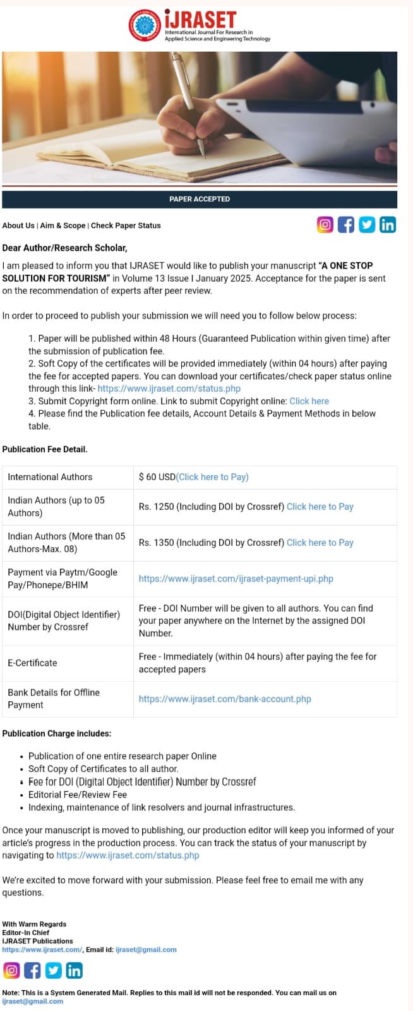
Publication Details

Slide 15

Thank You

